Slide 1
Web Application For ADHD Detection Using Machine Learning and Deep Learning
Nasir Hussain & Zaryab Khan
2006811 - 2006823
Engr. Khalil Ullah
Chairman Department of SE

Slide 2
TABLE OF CONTENTS
01
02
03
04
05
06
Problem Statement
Objective of Project
Tentative Schedule Plan
(Gantt Chart)
Literature Review
Diagrams
Implementation
07
08
09
Expected Results
Conclusion
References

Slide 3
Problem Statement
ADHD is a common neurodevelopmental disorder that affects children and adults. It is characterized by inattention, hyperactivity, and impulsivity.
Currently, ADHD diagnosis involves EEG or MRI tests, which can take several days to analyze. This can lead to delays in diagnosis and treatment.
To address this problem, we are developing a deep learning-based system that can analyze EEG and MRI data to predict ADHD disease with high accuracy and in real-time. This system will be made available to neurologists and locals as a user-friendly platform.
This innovation will benefit both neurologists and locals. Neurologists will be able to provide more timely insights to their patients, and locals will have access to a faster and more convenient way to get diagnosed with ADHD.

Slide 4

Objectives
ML and DL algorithms that analyze EEG and MRI Data accurately from individuals suffering from ADHD, providing precise results in minimal time (SDG 3)
Reducing the wait time, and providing accurate and rapid results by training the models on EEG signals and MRI scans (SDG 3)
Highest Accuracy in detection, minimizing false positives and false negatives to enhance diagnostic reliability (SDG 3)
Applying data pre-processing techniques on EEG such as noise reduction, artefact removal, and signal refinement (SDG 3)
Validating the model’s accuracy and reliability using real data of ADHD and non-ADHD patients to compare it with clinical standards (SDG 3, 17)
Accessibility of its application to healthcare professionals and patients seeking diagnosis (SDG 3, 10)

Slide 5
Objectives
Identification most suitable Machine learning algorithms for ADHD for performance improvement (SDG 3, 17)
Collaboration with healthcare institutions, neurologists, and experts to gain insights, enhance the model, and share the knowledge for the broader medical community’s benefit.

Slide 6
Tentative Schedule Plan (Gantt Chart)

Slide 7
Literature Review
Machine Learning Methods for Diagnosing ADHD Disorder Using Functional and Structural MRI: A Survey [1]
Abnormal Functional Resting-State Networks in ADHD: Graph Theory and Pattern Recognition Analysis of fMRI Data [2]
ADHD Detection Using Machine Learning Algorithms and EEG Brain Signals [3]

Slide 8
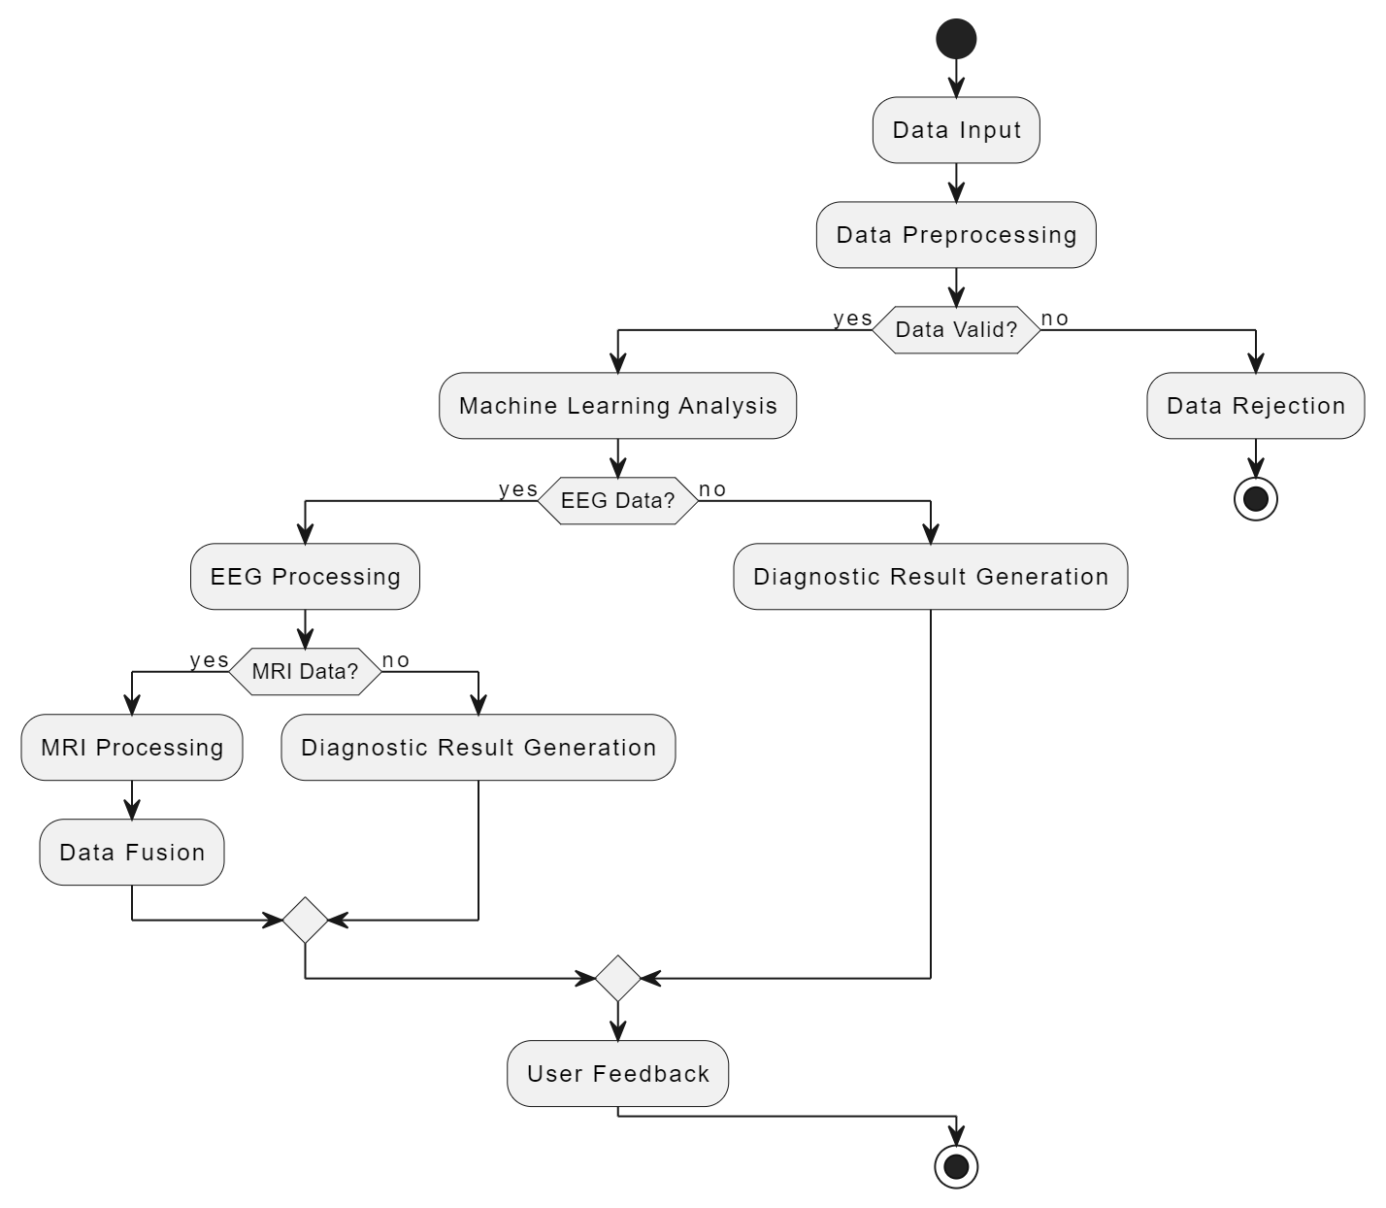
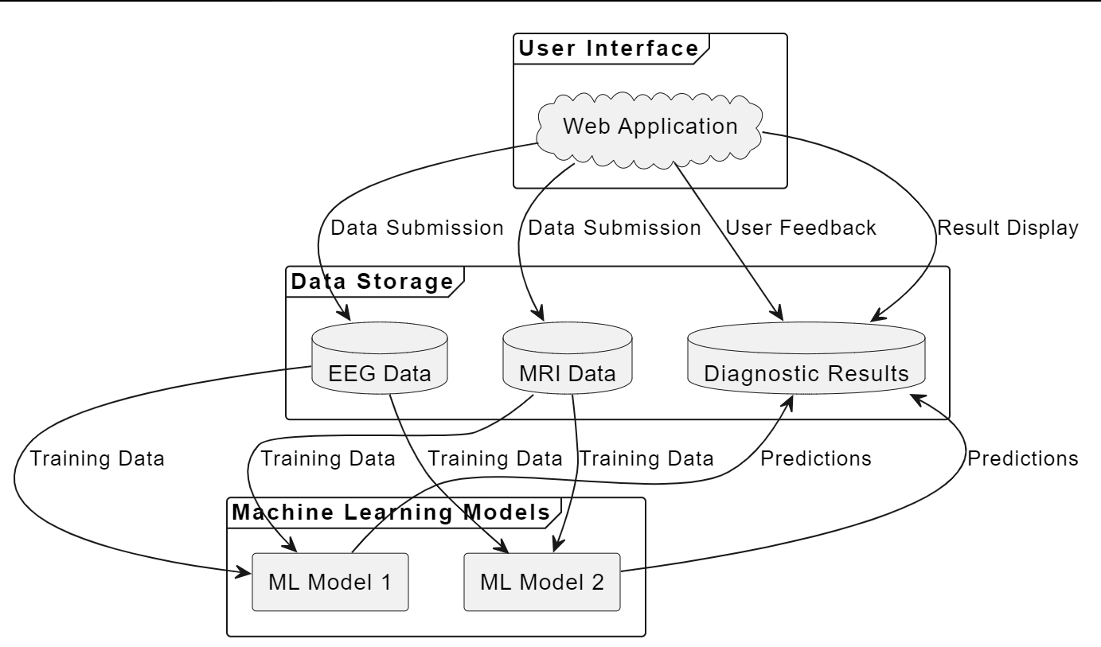
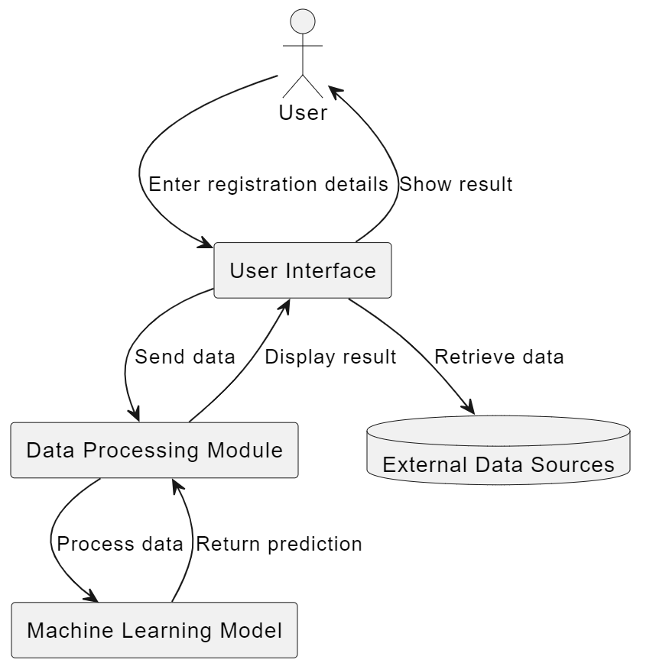
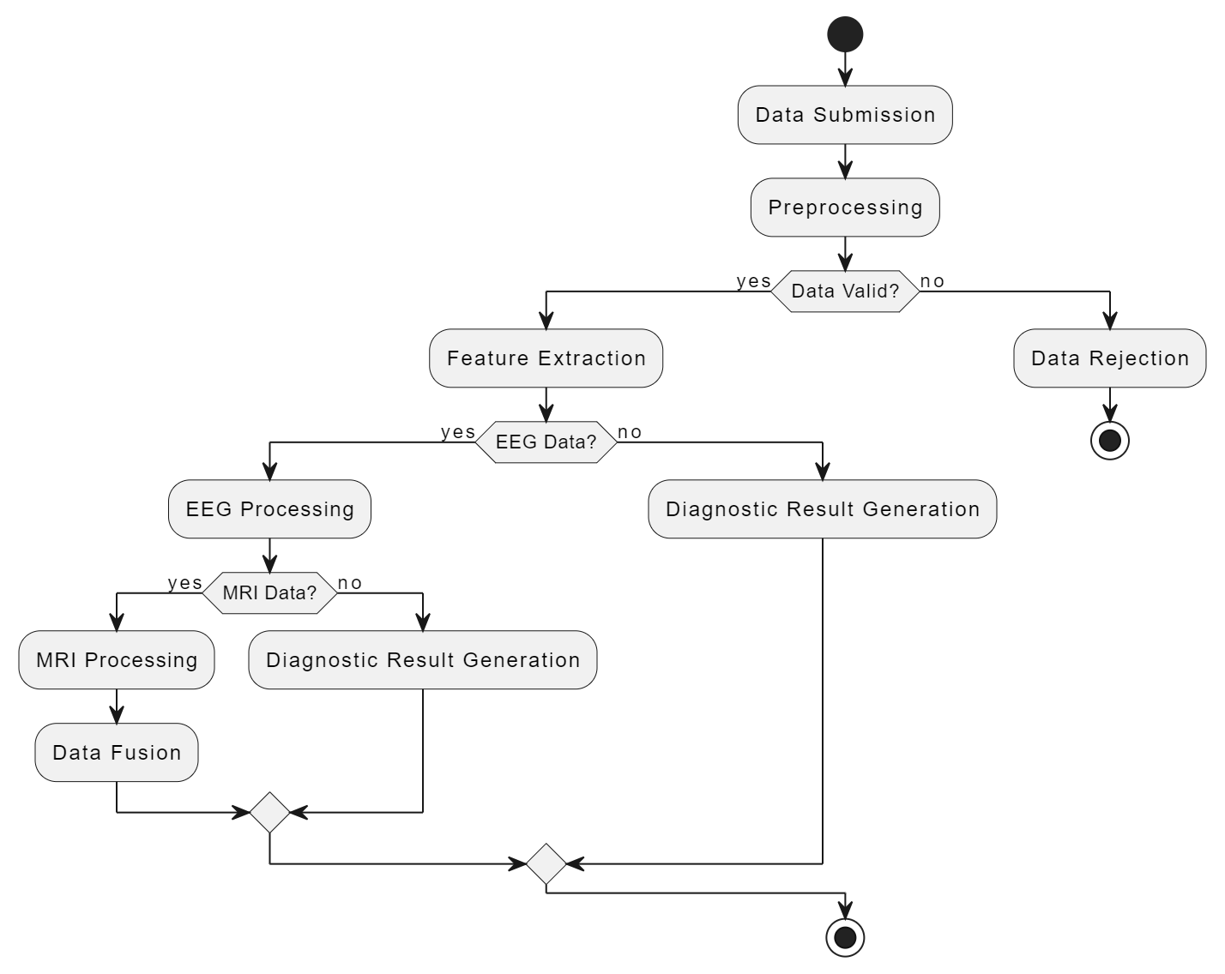
Diagrams
BLOCK DIAGRAM
FLOW CHART
PROCESS MODEL
SYSTEM MODEL

Slide 9
Implementation
For Data Manipulation and Operations
Libraries:
NumPy (performing any mathematical or scientific calculation)
Pandas(used for data wrangling and data manipulation purposes) Matplotlib(used for creating static, animated, and interactive visualizations)
Scikit-Learn(to implement machine learning models and statistical modeling)
Tensor Flow(used for deep learning or machine learning problems such as Classification, Perception, Understanding, Discovering Prediction, and Creation)
Framework:
PyTorch (PyTorch is an open-source machine learning (ML) framework based on the Python programming language and the Torch library)
User Interface
- React will be used for the Front-End UI Implementation
Database
- Due to the secure nature of user data in the project we have decided to use PostgreSQL in Place of MongoDB
Back-End
- For Backend implementation, we will use express.js for routing and servers, and node.js for real-time connectivity to the database.

Slide 10
Expected Results
Accessibility To ADHD Diagnosis
Reduced Cost Of ADHD Diagnosis
Improved Accuracy And Speed Of ADHD Diagnosis

Slide 11
Expected Results
The goal of this project is to create a user-friendly platform for deep learning and machine learning to detect ADHD. The platform will have a high degree of accuracy and be able to predict ADHD conditions in real-time by analyzing EEG data and MRI scans. The project has the potential to significantly advance both society and the area of medicine by;
Improving deep learning for detecting ADHD
Making the diagnosis of ADHD more widely available
Improving ADHD diagnosis precision
Elimination of disparity (difference in level of treatment) in the healthcare industry
Reducing the social cost of undiagnosed or incorrectly diagnosed cases of ADHD
In general, this project has the potential to significantly improve the lives of millions of people worldwide.

Slide 12
References
[1] Eslami, T., et al., "Machine learning methods for diagnosing autism spectrum disorder and attention-deficit/hyperactivity disorder using functional and structural MRI: A survey," Frontiers in Neuroinformatics, vol. 15, p. 62, 2021.
[2] Anderson dos Santos Siqueira, Claudinei Eduardo Biazoli Junior, William Edgar Comfort, Luis Augusto Rohde, João Ricardo Sato, "Abnormal Functional Resting-State Networks in ADHD: Graph Theory and Pattern Recognition Analysis of fMRI Data," BioMed Research International, vol. 2014, Article ID 380531, pp. 1-10, 2014.
[3] A. T. Swadi and F. S. Miften, "ADHD Detection Using Machine Learning Algorithms and EEG Brain Signals," Journal of Education for Pure Science-University of Thi-Qar, vol. 13, no. 1, pp. 43-55, 2023.

